Slide 1
Basic Information of this Course
Electromagnetics (电磁学)
Students: Majoring in EE
Feb. 19, 2019 ~ June 7, 2019 (16 weeks)
Classroom: Teaching Center Rm. 302
Lecture: Tuesday & Thursday 10:15 ~ 11:55
Lab session: SIST Bldg. Rm. 1D102 Small Class 1: Monday 15:55 ~ 17:35 Small Class 2: Tuesday 15:55 ~ 17:35 Small Class 3: Wednesday 13:00 ~ 14:40 Small Class 4: Thursday 15:55 ~ 17:35 Detailed schedule will be determined later
Quiz: every week (TBD)
Discussions and Exercises: every week (TBD)
互动教学平台: 电磁学-2019春-王雄

Slide 2
Information of Instructor
Xiong Wang (王雄), Assistant Professor
Office: SIST Bldg., Rm. 1D301B
Office hour: Tuesday 13:00~15:00
Telephone: 20685264
Email: wangxiong@shanghaitech.edu.cn
WeChat: wangxiong_shtech

Slide 3
Information TAs and Lab Teacher
TAs (grader) 巴钟灵 bazhl@shanghaitech.edu.cn 张修豪 zhangxh@shanghaitech.edu.cn 齐正坤 qizhk@shanghaitech.edu.cn 黄少明 huangshm@shanghaitech.edu.cn 王思凡 wangsf@shanghaitech.edu.cn
TAs (lab) 孙逸飞 sunyf1@shanghaitech.edu.cn 李昊燕 lihy1@shanghaitech.edu.cn 李琳 lilin@shanghaitech.edu.cn 姚进 yaojin@shanghaitech.edu.cn
Lab teacher 李娟 lijuan@shanghaitech.edu.cn

Slide 4

Our WeChat Group

Slide 5
Policies
Attitude: work hard during the entire semester
Integrity: homework, quiz, exams, lab, class projects (will be included in the final grade)
Attendance: Lecture: required, about 8 random roll call in about 30 lecture days (may be included in the final grade) Lab: required, 0 point for one lab session if absent. Reschedule is possible, but needs to get my permission before it starts Quiz: required. Make-up is possible, but get a 30% deduction in the points and no more than two times during this semester. I MUST be informed by email or WeChat before each quiz starts Exam: required, 0 point for one exam if absent and no make-up exam is allowed

Slide 6
Policies (cont.)
Classroom discipline: DO NOT allow playing games and watching videos on smart phones, tablets or laptops in class
Homework: assigned every week and collected next week in class. If you cannot finish it on time, you can turn in on the next class day but with a 20% deduction of the points. No homework is accepted after that. Everyone should try to work on homework problems independently. Discussion between students and searching online is allowed, but you must finally work on it by yourself even if you get some help elsewhere. Copying from each other, copying solutions, or copying the old-version homework of the junior students will be strictly punished. Please keep in mind that all the problem numbers of homework refer to those in the 7th edition of our textbook

Slide 7
Policies (cont.)
Quiz: quiz is given for about 10 times. The problems are very basic questions, calculations, or derivations based on the two lectures in the past week. All quizzes are closed-book, closed-notes, and no cheat sheet is allowed. Any kind of cheating in a quiz will lose all points for quiz in the final grade, and cheating in two quizzes will fail the class
Exams: one midterm and one final. Closed-book and closed-notes, but can take some pages (2 for midterm and 3 for final) of A4 size cheat sheet with equations, notes, figures or whatever you want to write on both sides of the papers. You need to get a calculator that can do calculations of complex numbers, exponential operation, trigonometric function and so on. Any kind of cheating in an exam will fail the class

Slide 8
Policies (cont.)
Lab session: students are grouped into teams of 2 members for each lab session. Both team members work together to finish all the required steps for an experiment and write a lab report together. Some reading is needed for some lab sessions before doing the experiments. The equipment and accessories will be used in labs are very expensive, so very careful operation is required and you must follow the guidance of the teacher or TAs
Bonus points: 0.5,1 or 1.5 points per time is awarded to students who can answer some of my questions and ask me in-depth questions (will be directly added to the final grade)

Slide 9
Project for EE Major (2 Extra Credits)
Hopefully will start around the 14th week and is extended to the Summer Semester
Several topics are available to choose. Students are encouraged and welcome to discuss possible topics designed by themselves
Students are grouped into teams of 2 or 3 and each team work on the selected topic together
Each project topic involves literature study, theoretical design, simulation using software, coding, fabrication, measurement, and report writing
Some topics can be further explored to gain you more experience in research and publishing a paper is also possible

Slide 10
Major Purposes of This Course
Expose you with fundamental knowledge, phenomenon, and applications of electromagnetics

Slide 11
Teaching Style
Not only knowing the hows but also the whys
Intuitive interpretation and practical examples of some elusive concepts, theorems, formulas, and phenomena. In another word, using physics to explain mathematics and taking advantage of some intuitive examples to unravel physics
Try to make you understand the most basic and important concepts in class

Slide 12
Course Content
See the syllabus
See list of questions related to EM

Slide 13
Statics vs. Dynamics
Electrostatics (does not change with time)
Magnetostatics (does not change with time)
Electromagnetics (vary with time, i.e. time-varying)
Electrostatics
DC
Decoupled
Fields
Force
Magnetostatics
Electromagnetics
AC
Coupled
Waves
Energy

Slide 14
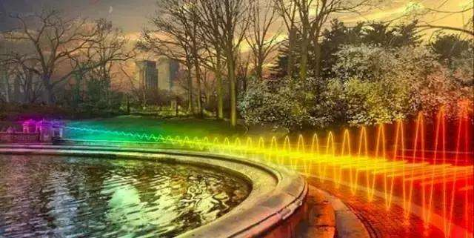
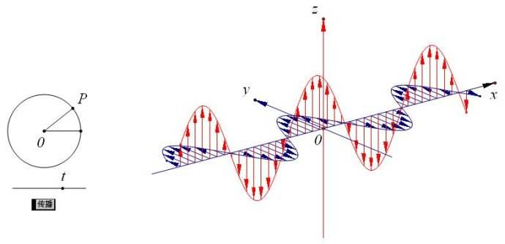
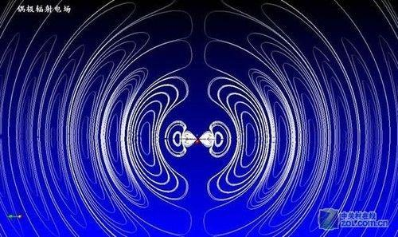
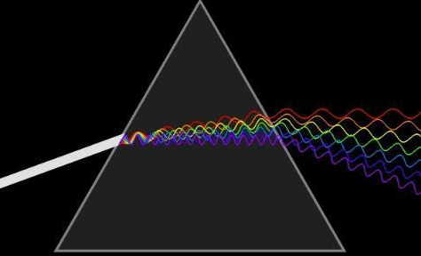
Common Illustration of EM Waves

Slide 15
Fields of Moving Charges
A good resource
http://phet.colorado.edu/sims/radiating-charge/radiating-charge_en.html
A static charge produces static electric field at the speed of light
When a charge is moving, the generated electric fields change accordingly
When the charge moves with acceleration, the generated electric fields exhibit oscillating natures, which will in turn generate magnetic fields and form electromagnetic fields

Slide 16
Examples of EM Applications

Slide 17
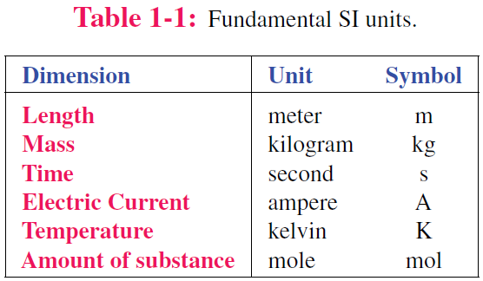
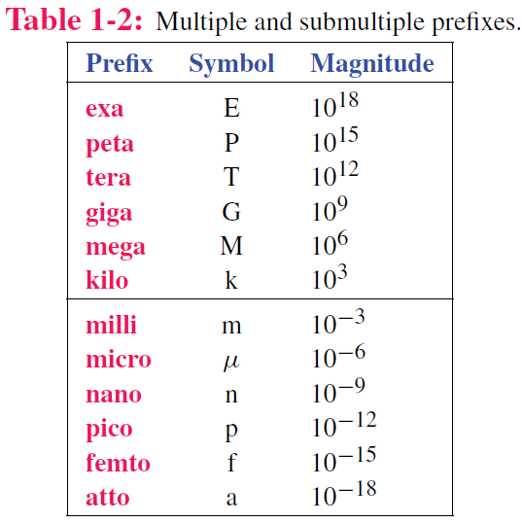
Dimensions and Units
Luminous intensity candela cd

Slide 18
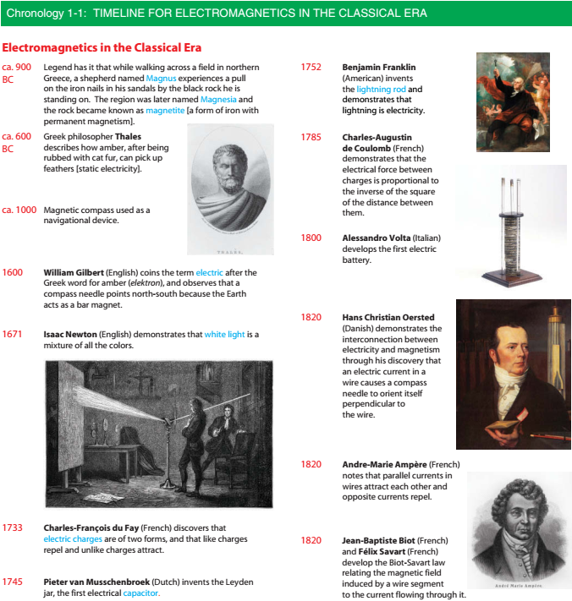

Slide 20
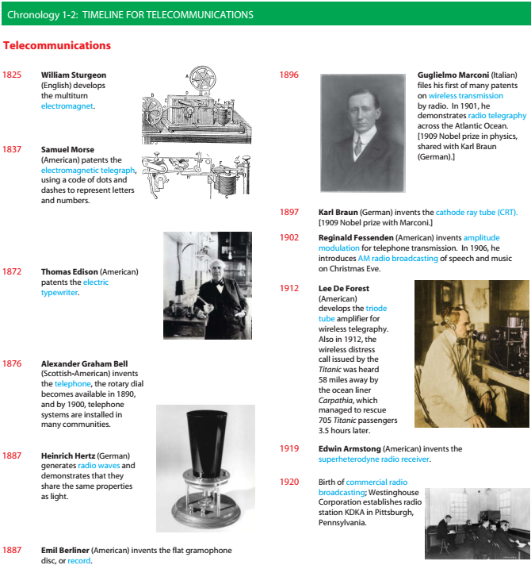

Slide 22
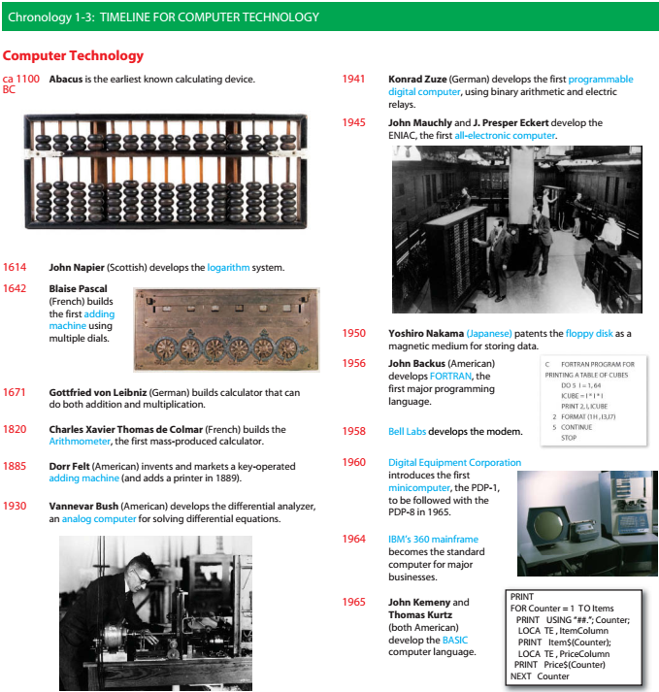

Slide 24
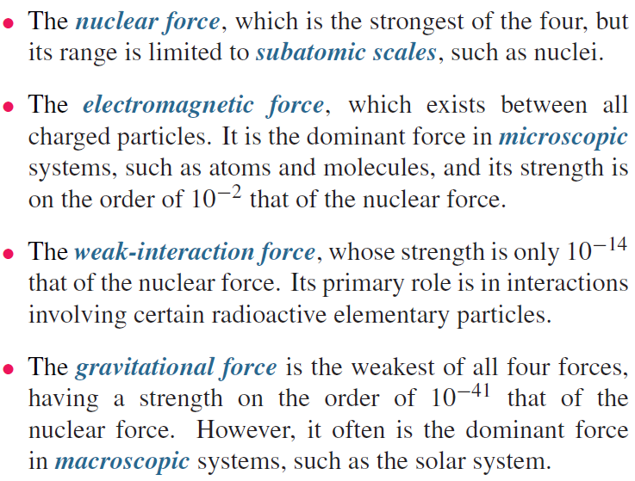
Fundamental Forces of Nature

Slide 25
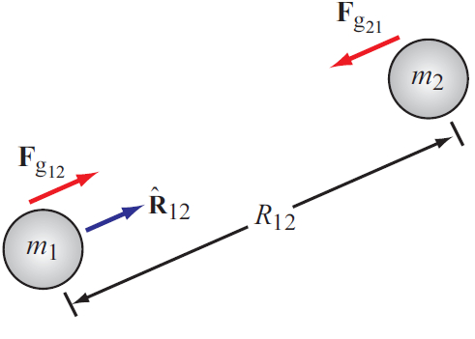
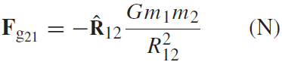
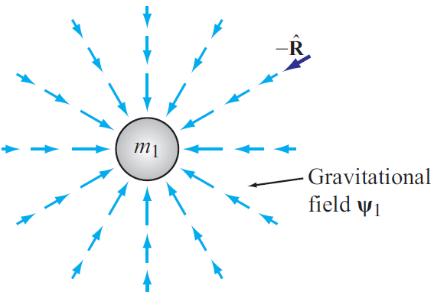
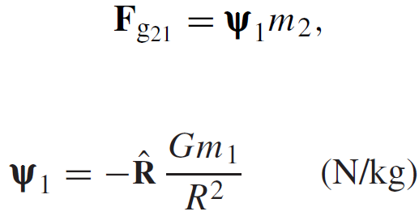
Gravitational Force
Force exerted on mass 2 by mass 1
Action at a distance
Gravitational FIELD induced by mass 1

Slide 26
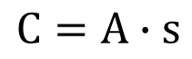
Charge: Electrical property of particles
Units: coulomb
Charge of an electron
One coulomb: amount of charge accumulated in one second by a current of one ampere.
e = 1.602 x 10⁻¹⁹ C
Charge conservation
The coulomb is named for a French physicist, Charles-Augustin de Coulomb (1736-1806), who was the first to measure accurately the forces exerted between electric charges.
Cannot create or destroy charge,
only transfer
$$C=A∙s$$

Slide 27
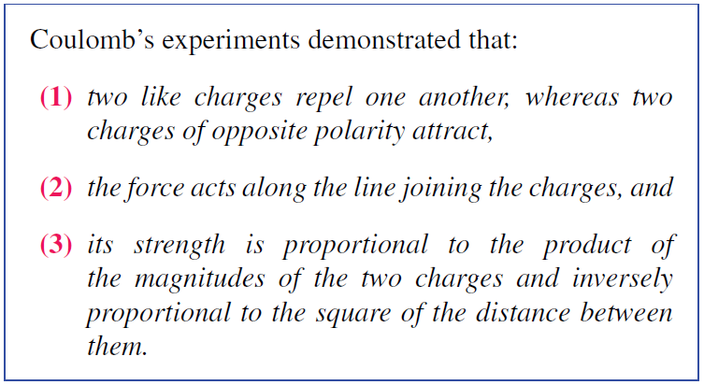
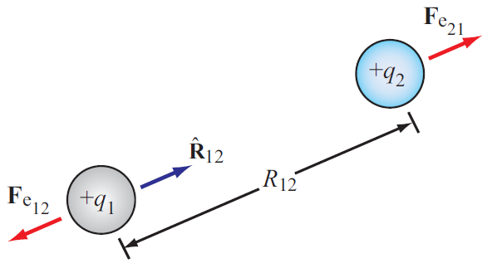
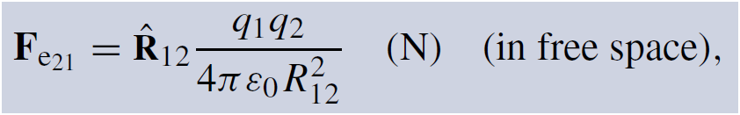
Electrical Force
Two differences between F_{g} and F_{e}
Force exerted on charge 2 by charge 1
Permittivity of free space
ε₀ = 8.854 × 10⁻¹² farad per meter (F/m)

Slide 28
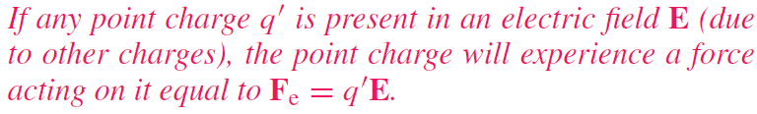
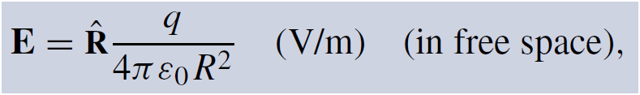
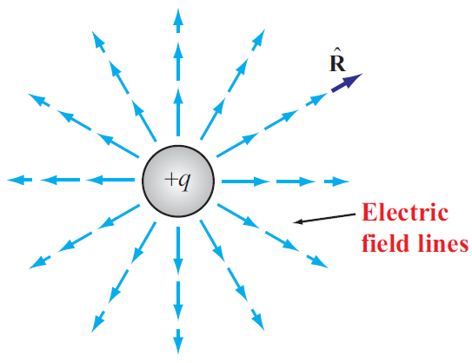
Electric Field In Free Space
Permittivity of free space

Slide 29
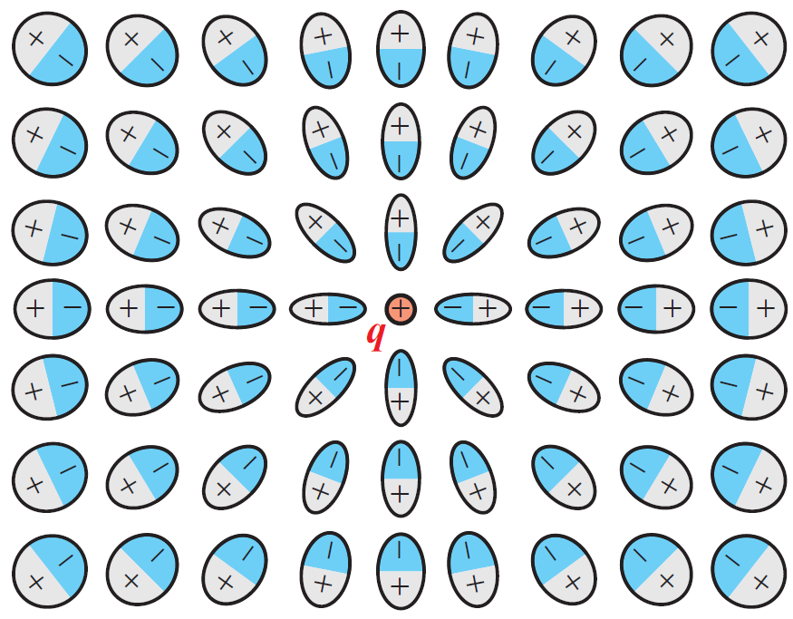
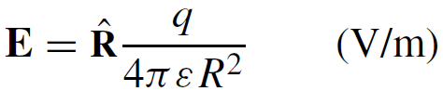
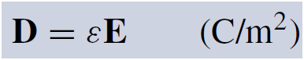
Electric Field Inside Dielectric Medium
Polarization of atoms changes electric field
New field can be accounted for by changing the permittivity
Permittivity of the material
Another quantity used in EM is the electric flux density D:
Electric dipole
The fields of dipoles tend to counteract the field due to the positive charge

Slide 30
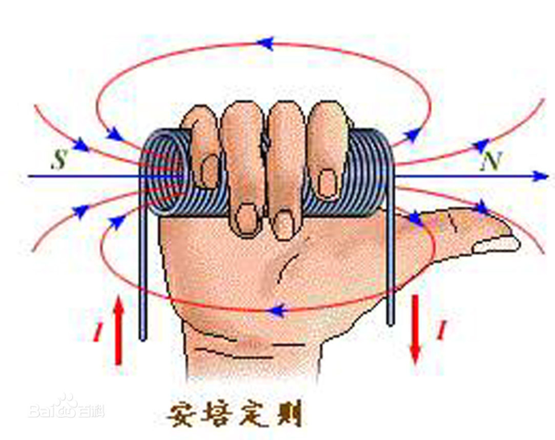
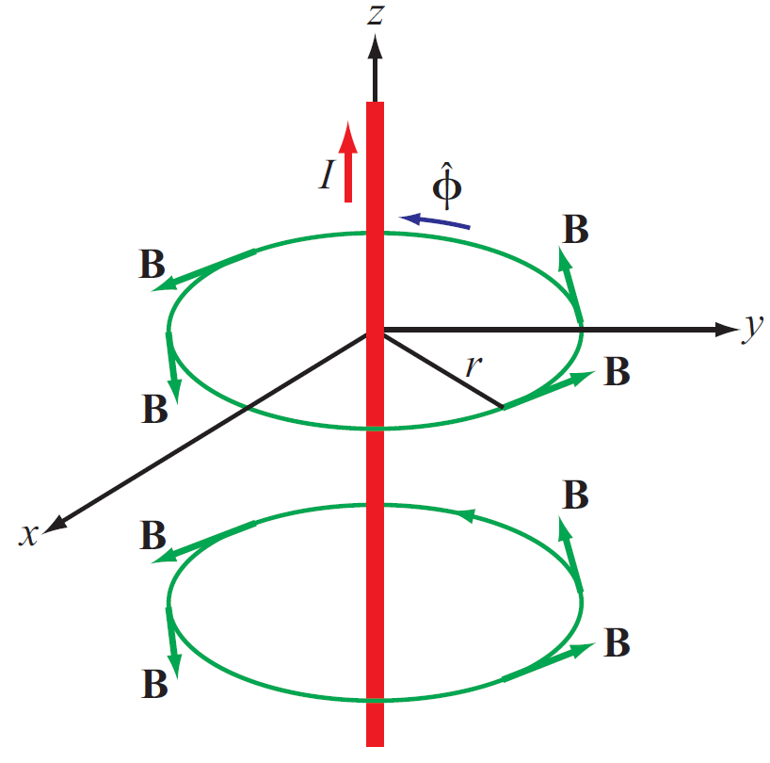
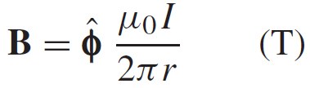
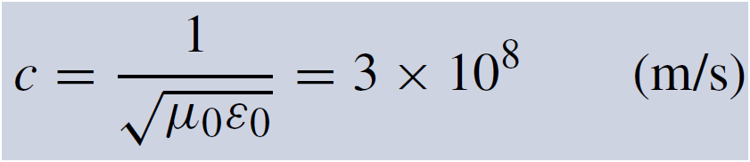
Magnetic Field In Free Space
Electric charges can be isolated, but magnetic poles always exist in pairs.
Magnetic field induced by a current in a long wire
Magnetic permeability of free space
Electric and magnetic fields are connected through the speed of light:

Slide 31
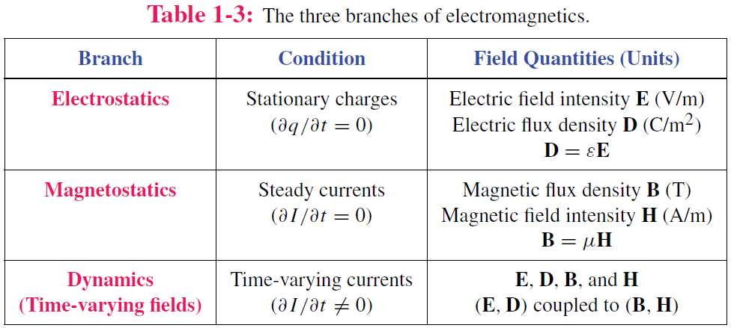
Static vs. Dynamic
Static conditions: charges are stationary or moving, but if moving, they do so at a constant velocity.
Under static conditions, electric and magnetic fields are independent, but under dynamic conditions, they become coupled.

Slide 32
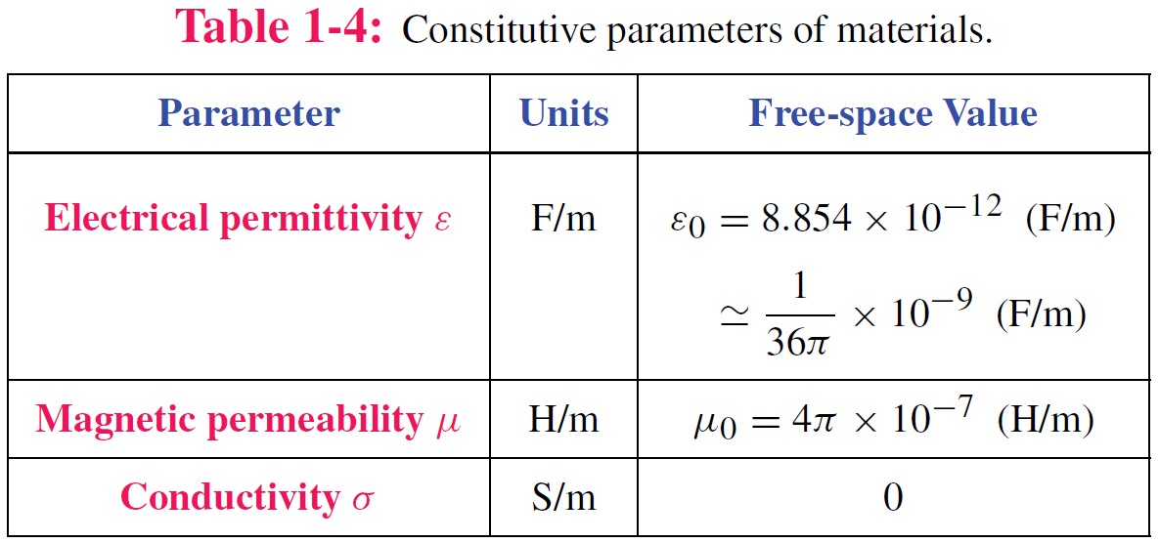
Material Properties

Slide 33
Traveling Waves
Waves carry energy
Waves have velocity
Many waves are linear: they do not affect the passage of other waves; they can pass right through them
Transient waves: caused by sudden disturbance
Continuous periodic waves: repetitive source

Slide 34
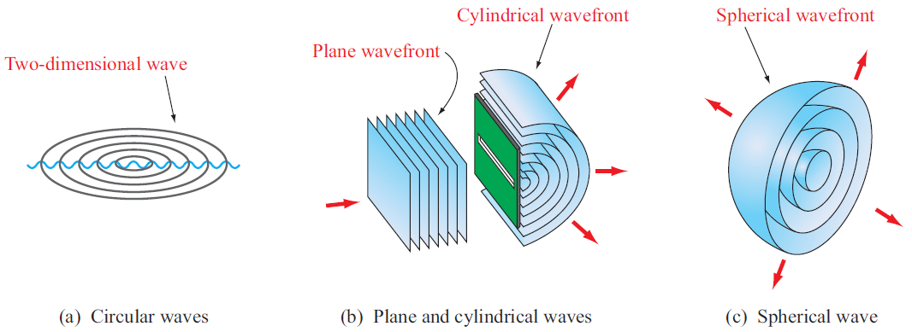
Types of Waves
Surface with equal phase

Slide 35
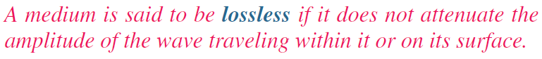
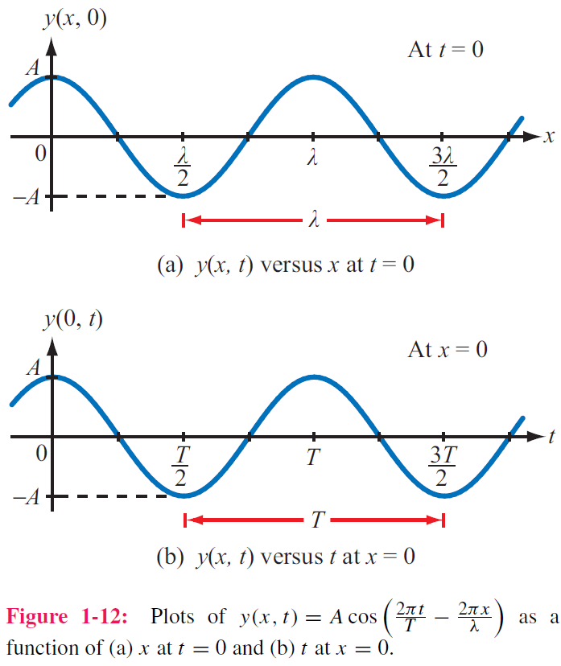
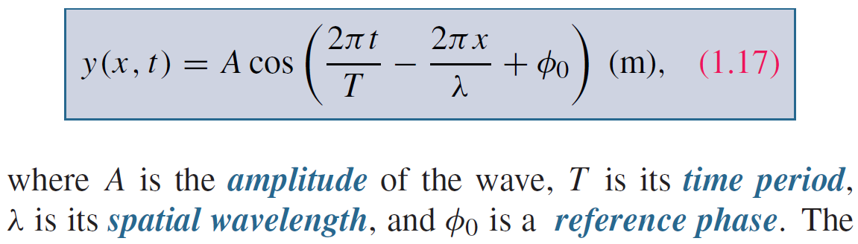
Sinusoidal Waves in Lossless Media
Take wave on water as an example
y = height of water surface
x = distance
Function of both time and space

Slide 36
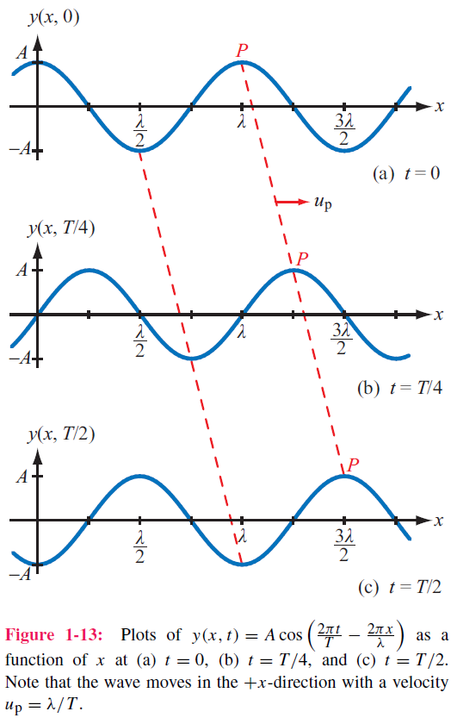
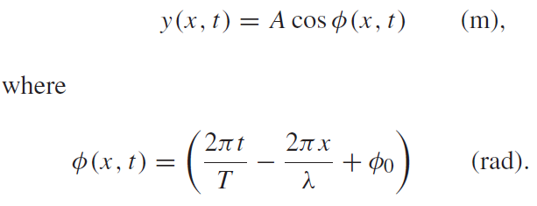
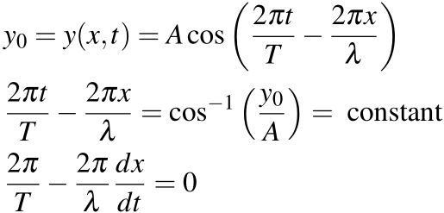
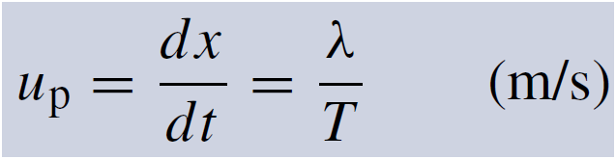
Phase velocity
If we select a fixed height y₀ and follow its progress, then

Slide 37
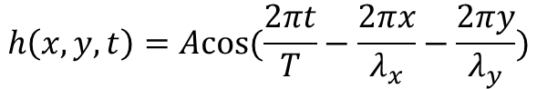
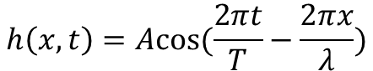
More Interpretation of Spatial Variables
The spatial variables in the cos function represent the directions in which the wave has propagation
$$h\left(x,t\right)=Acos(\frac{2πt}{T}−\frac{2πx}{λ})$$
$$h\left(x,y,t\right)=Acos(\frac{2πt}{T}−\frac{2πx}{λ_{x}}−\frac{2πy}{λ_{y}})$$

Slide 38
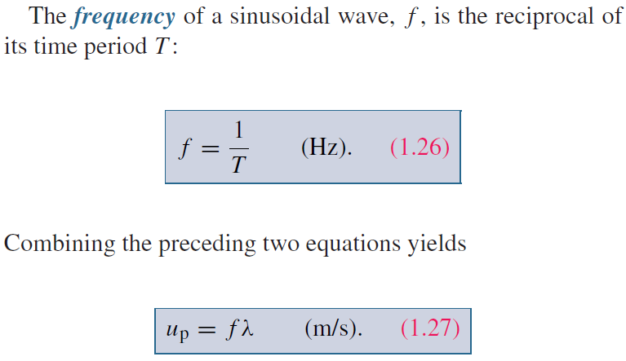
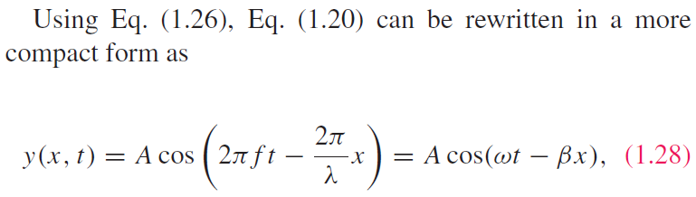
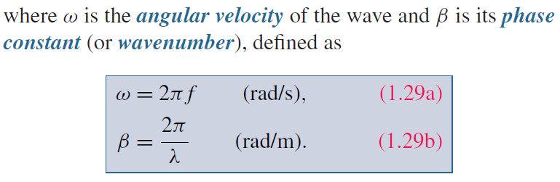
Wave Frequency and Period

Slide 39
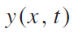
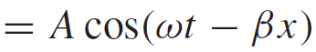
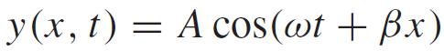
Direction of Wave Travel
Wave travelling in +x direction
As t increases, x has to increase to make (ωt − βx) constant
Wave travelling in ‒x direction
As t increases, x has to decrease to make (ωt + βx) constant
+x direction: if coefficients of t and x have opposite signs
‒x direction: if coefficients of t and x have same sign (both positive or both negative)

Slide 40
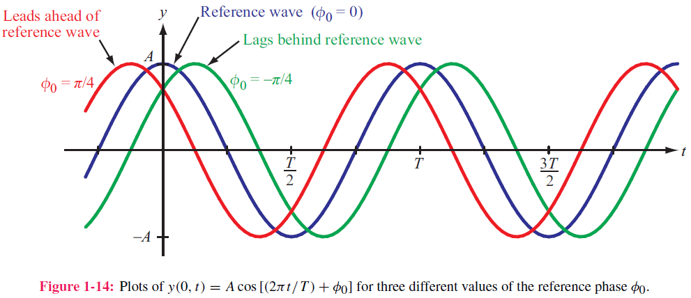
Phase Lead & Lag
t₀
t₀−T/4
T₀+T/4

Slide 41
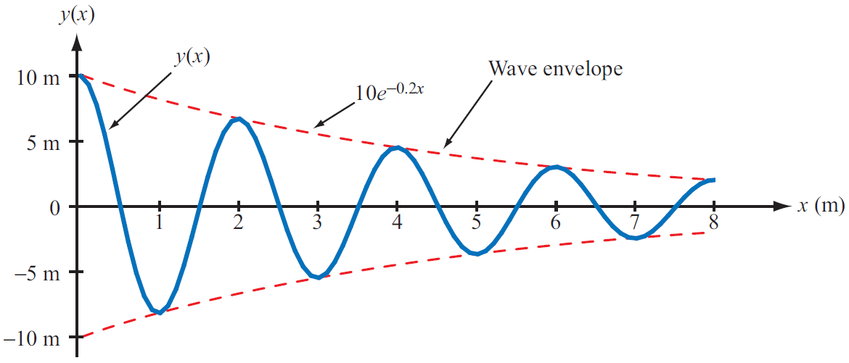
Wave Travel in Lossy Media
Frequency does not change
Attenuation factor

Slide 42
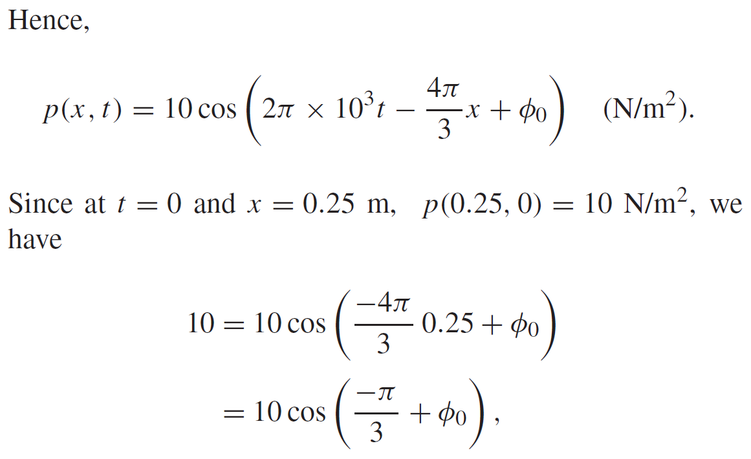
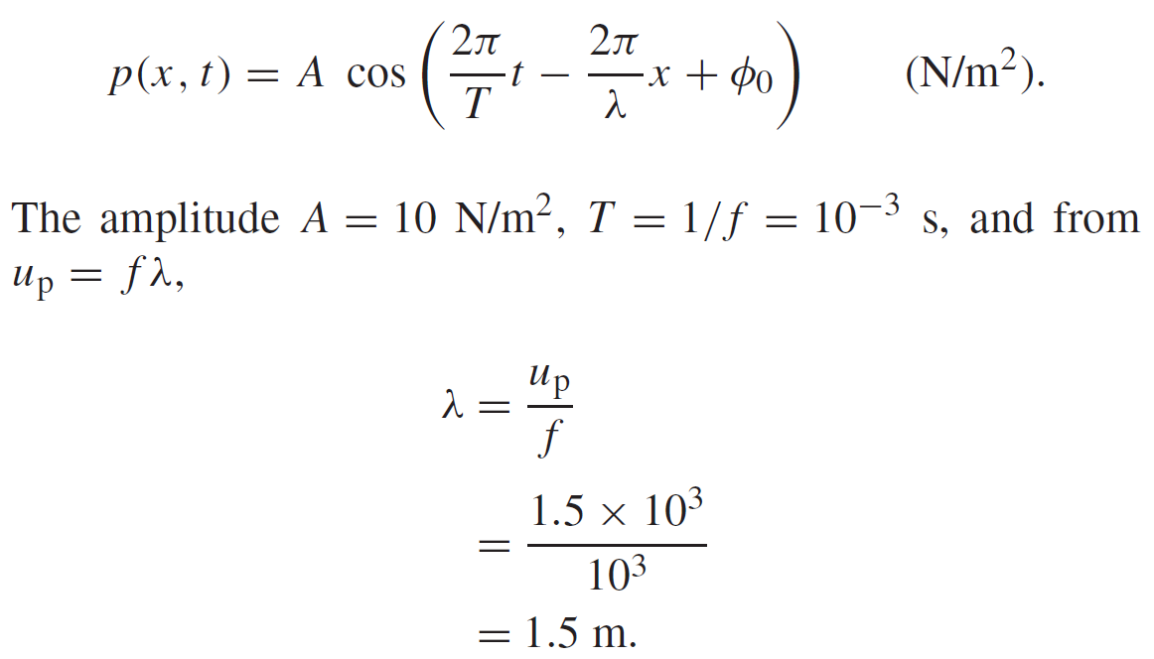

Example 1-1: Sound Wave in Water
Given: sinusoidal sound wave traveling in
the positive x-direction in water
Wave amplitude is 10 N/m2, and p(x, t) was observed to be at its maximum value at t = 0 and x = 0.25 m. Also f=1 kHz, up=1.5 km/s.
Determine: p(x,t)
Solution:

Slide 43


Slide 44


The EM Spectrum

Slide 45


Slide 46

Complex Numbers
We will find it is useful to represent sinusoids as complex numbers
Rectangular coordinates
Polar coordinates
Relations based on Euler’s Identity

Slide 47

Relations for Complex Numbers
Learn how to perform these with your calculator/computer

Slide 48

Phasor Domain
1. The phasor-analysis technique transforms equations
from the time domain to the phasor domain.
2. Integro-differential equations get converted into
linear equations with no sinusoidal functions.
3. After solving for the desired variable--such as a particular voltage or current-- in the phasor domain, conversion back to the time domain
provides the same solution that would have been obtained had the original integro-differential equations been solved entirely in the time domain.

Slide 49


Phasor Domain
Phasor counterpart of $v(t)$
Phase is needed

Slide 50

Time and Phasor Domain
It is much easier to deal with exponentials in the phasor domain than sinusoidal relations in the time domain
Just need to track magnitude/phase, knowing that everything is at frequency ω

Slide 51

Phasor Relation for Resistors
Current through resistor
Time Domain
Frequency Domain
Time domain
Phasor Domain

Slide 52


Phasor Relation for Inductors
Time domain
Phasor Domain
Time Domain

Slide 53



Phasor Relation for Capacitors
Time domain
Phasor Domain

Slide 54

Example
Sine reference
Integral property
Cosine reference

Slide 55







ac Phasor Analysis: General Procedure

Slide 56
Example 1-4: RL Circuit
Cont.

Slide 57
Example 1-4: RL Circuit cont.

Slide 58

Travelling Waves in Phasor Domain

Slide 59

Summary

